Slide 1
Cage Card Requests
The following requests can be completed in the Kuali Animal Management system:
Weaning
Splits/Separations
Joins
Any requests made will be routed through LAR system administration for approval.

Slide 2
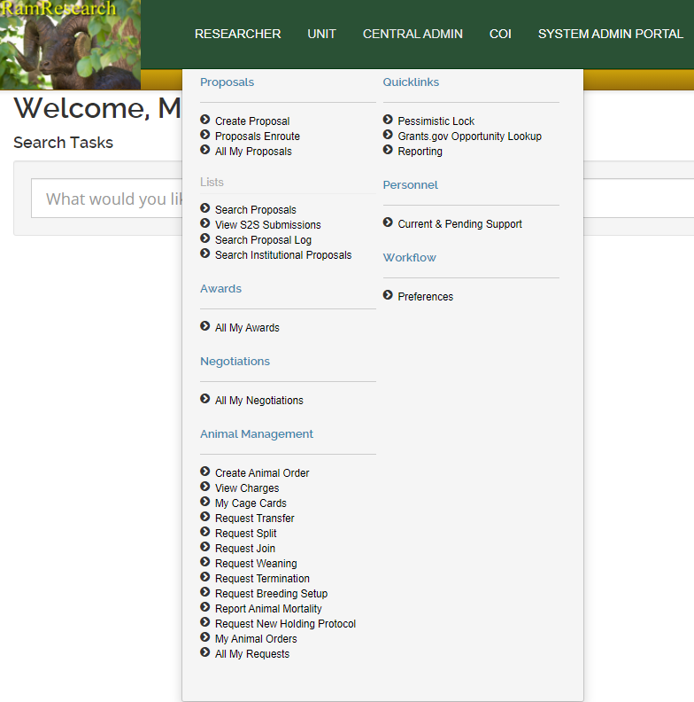
Requesting a Wean, Split or Join:
Log into Kuali Research using your CSU credentials
Open the RESEARCHER menu and find the Animal Management menu
Click on the needed request option

Slide 3
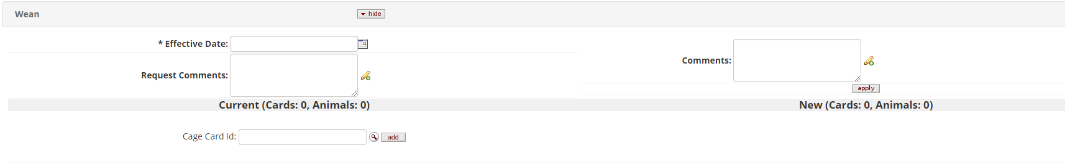
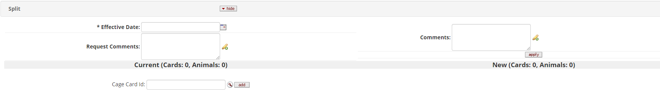
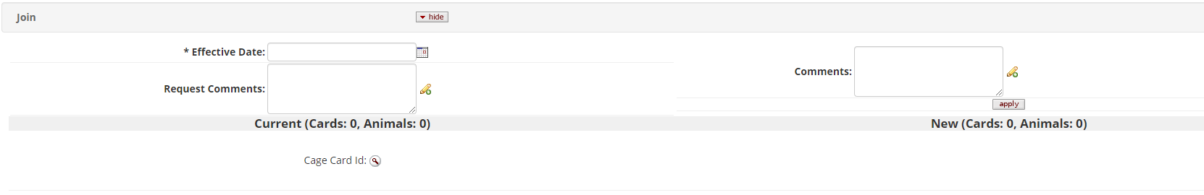
All three types of requests will open to the same page with an effective date, request comments, comments for the cage cards and a place to search for or enter in a cage card number

Slide 4
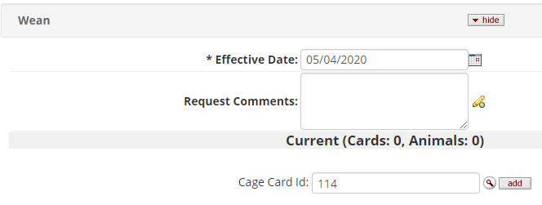
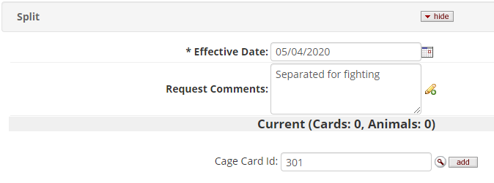
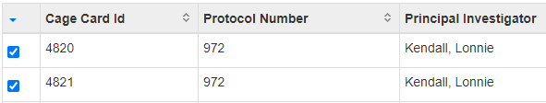
Start with entering in the effective date for the request and insert any request comments
Select the cage card(s) that need to be in the request
  For Weans, enter in (or search for) the breeder cage card number and press “add”
  For Splits, enter in (or search for) the cage card number that will have animals separated from it and press “add”
  For Joins, use the magnifying glass to search for and select the two or more cage cards that will be joined together; after checking the boxes next to the cage card IDs, click “return selected” at the bottom of the page

Slide 5
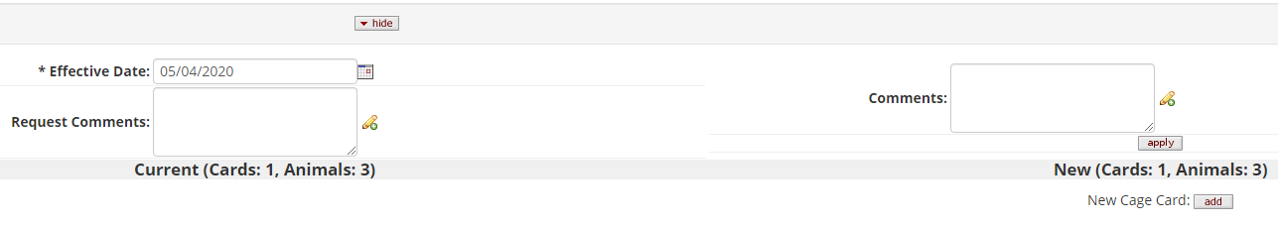
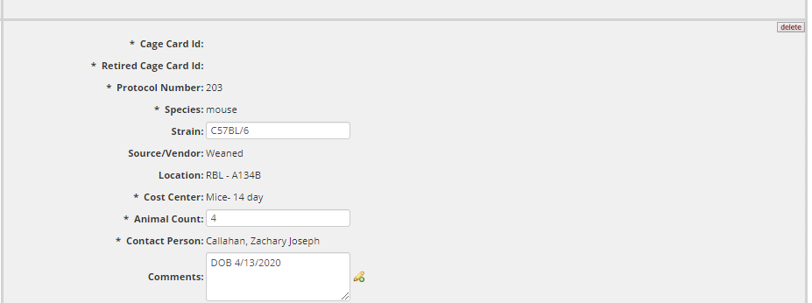
Weans
The parent cage card will be visible as the first cage card in the Current column as well as in the New column
At the top of the New column, there is a button to “add” a New Cage Card; create a new card for each cage of weanlings
The Strain, Animal Count and Comments can be edited on each new cage card
Comments entered in the box at the top of the New column can be applied in bulk to all new cage cards when “apply” is pressed
There is a “delete” button on each weaned cage card in the event you created too many
All new cage cards created will use the same location, contact person and accounting information as the parent cage card
  Should this information need to be different, specify in the request comments section

Slide 6
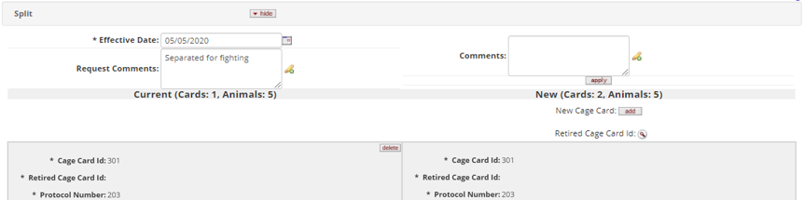
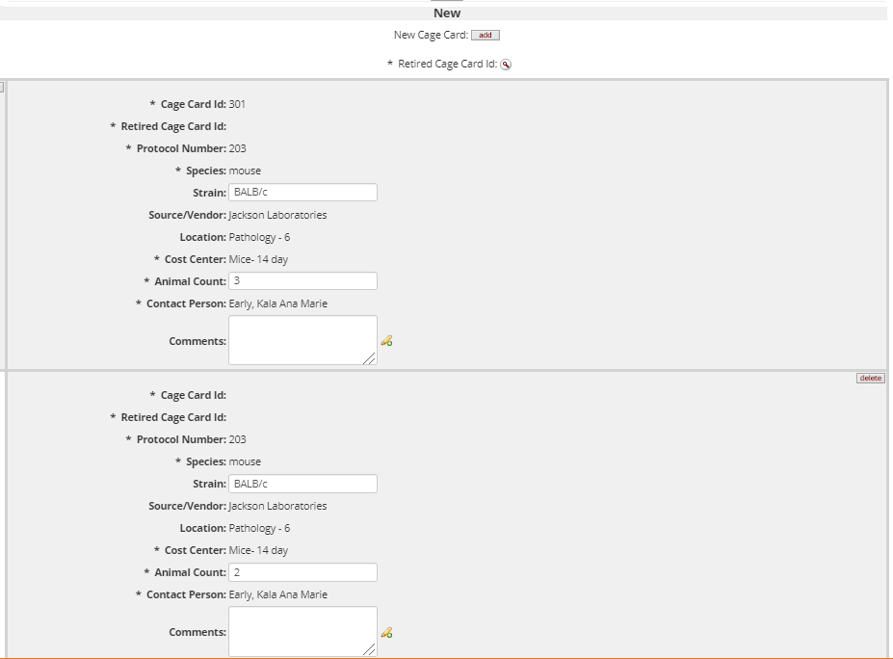
Splits
The cage card that is being split will show at the top of the Current and New columns
Under the New column header, there is a button to “add” a new cage card or to search for a Retired Cage Card
  Retired cage cards should be used if an animal needs to be moved back to a stopped cage card
The Strain, Animal Count and Comments can be edited for each card; the Comments can be edited in bulk at the top of the request
Any new card can be removed from the request with the “delete” button on the right side of the card
All new cage cards created will use the same location, contact person and accounting information as the original cage card
NOTE: The sum of the animal counts in the New column must equal the number of animals on the cage card in the Current column

Slide 7
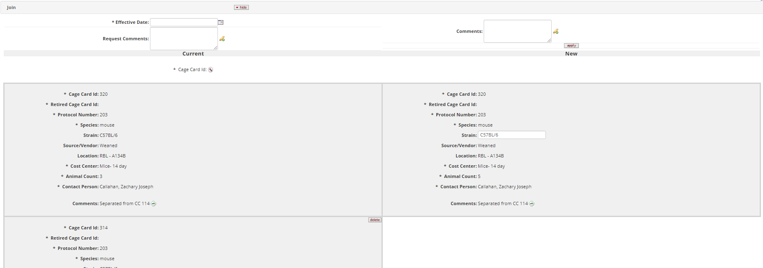
Joins
The cage cards selected will appear under the Current column on the left side of the page
The animals from the second cage will be consolidated into the first cage card, and the New cage card will show on the right side of the page
The strain of the animals can be updated on the New cage card
Comments can be added to the New cage card using the Comments box at the top of the request and pressing “apply”
NOTE: The New cage card has the same CC ID as the top most cage card; ensure this cage card is the one on the physical cage

Slide 8

After you have completed your request, “submit” the request at the bottom of the page or “save” the request for later submission
Once submitted or saved, the request will be given an Allocation ID in the top right side of the screen; reference this allocation ID in any correspondence with LAR
Lastly, you will receive an email once the request has been processed and approved

Slide 9
Please Note:
All requests will route through LAR approval; if there are any issues with the request, you will receive an email for clarification
If you have made a mistake in your request, email LAR staff at lar_cage_card_requests@Mail.Colostate.edu with the correction and the allocation ID
Location, Contact Person and Accounting information will be carried over from the parent/original cage card. If you know that this information should be different for the new cage cards, include the correct information in the Request Comments
For “For Census Only” requests, include a note in the Request Comments that no cage cards are needed

Slide 10
If you have any questions, please reach out to:
Megan Fritz
MeganR.Fritz@colostate.edu
(970)491-6012
Last Update: 12/4/2020

