Slide 1
Breeding Setup Requests
The Breeding Setup request should be used to:
Request a new cage card for a newly established breeding pair you have created
Request a new cage card for a new cage that was created when multiple cages were combined
If you require LAR Tech Services to set up the breeding pair for your lab, please request this service through the LAR Work Order system
Any requests made will be routed through LAR system administration for approval.

Slide 2
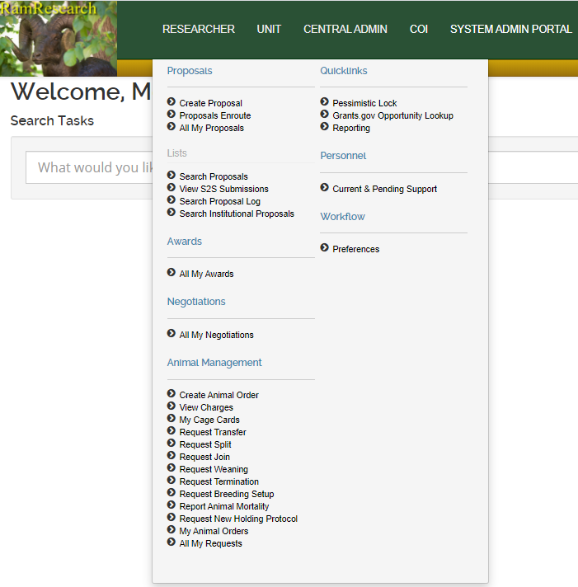
Open the Researcher menu and click the Request Breeding Setup option under the Animal Management menu

Slide 3
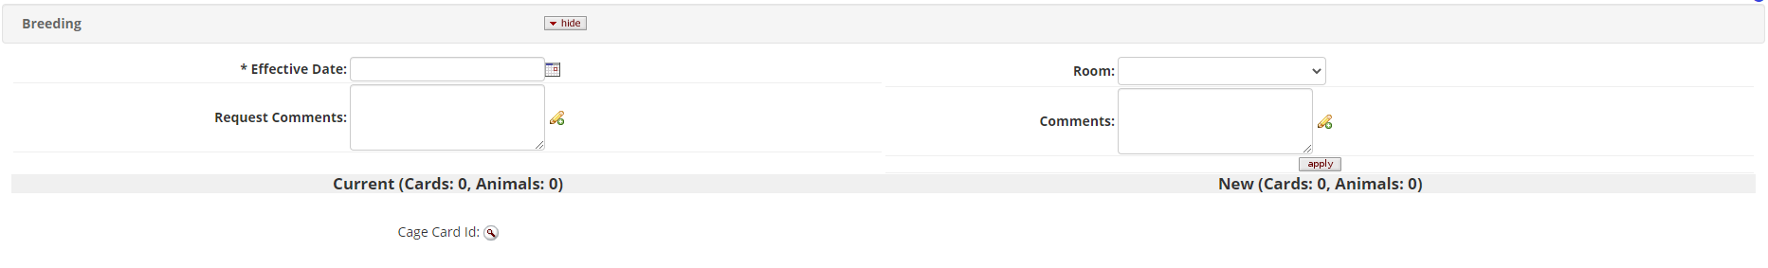
The request will look similar to most other requests when opened;
Begin with entering in the Effective Date as the date the breeder cage card was established
Add in any Request Comments if needed

Slide 4
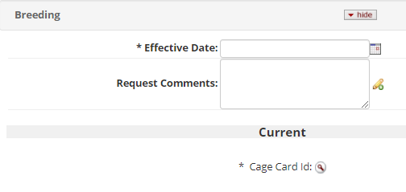
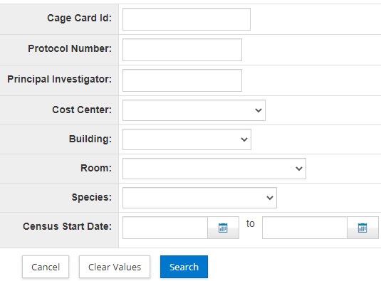
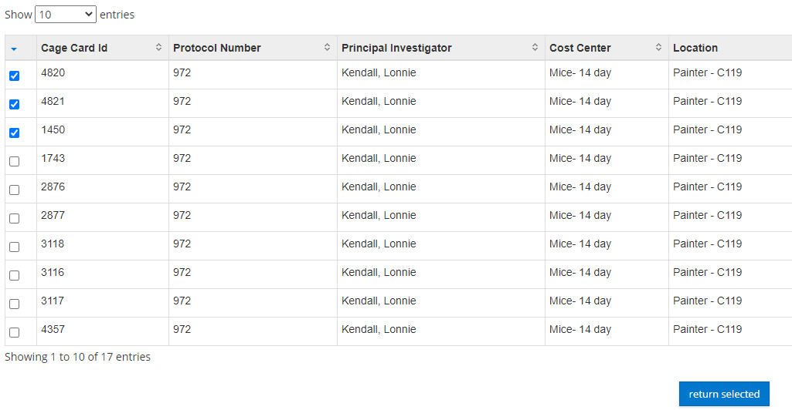
Select the cage cards that need to be in the request by clicking on the magnifying glass next to ‘Cage Card Id:’
In the Cage Card Lookup, refine your search by entering in the protocol number and the location of the cages that were combined into a new cage
Check the boxes next to the desired cage cards in the table of results and click on the “return selected” button at the bottom of the table

Slide 5
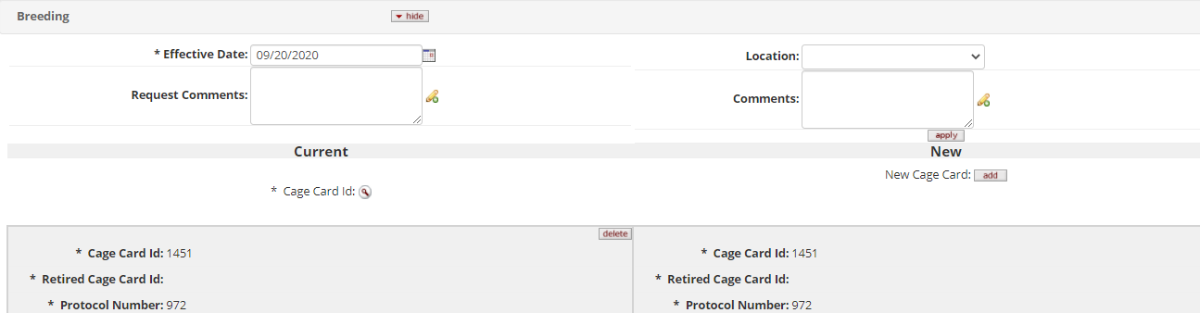
The selected cage cards will now appear in the request; to add a new cage card (the new breeder card), click on the “add” button at the top of the New column
A new cage card with the same protocol, species, strain, location and cost center will appear at the bottom of the New column

Slide 6
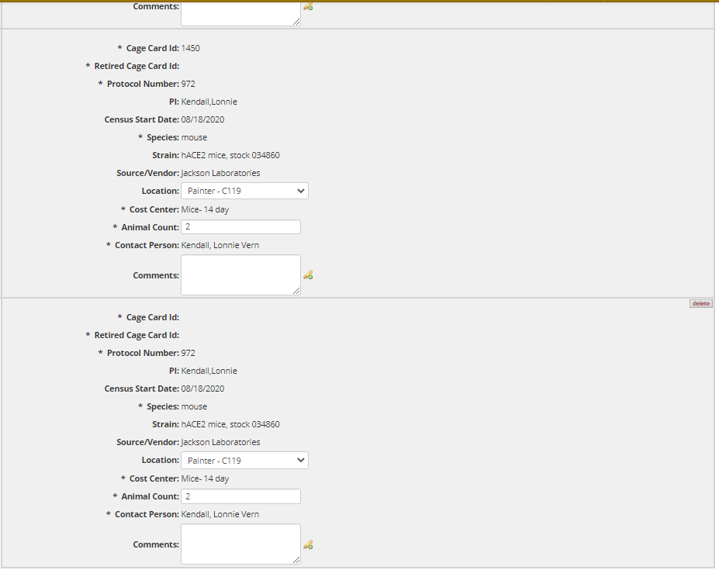
Edit the Animal Count on all the cage cards to reflect the new distribution of animals between all the cages
The total number of animals must not differ between the Current and the New columns:
Current
New
CC #1 : 4 mice
CC #1 : 5 mice
+
CC #2 : 2 mice
CC #2 : 3 mice
New CC: 2 mice

Slide 7
Once the Animal Counts have been edited and any other changes made to the cards (Comments and location), press the “submit” button at the bottom of the request
The request will route to LAR admins for approval and you will receive an email once the request is approved

Slide 8
Please Note:
All requests will route through LAR approval; if there are any issues with the request, you will receive an email for clarification
If you have made a mistake in your request, email LAR staff at lar_cage_card_requests@Mail.Colostate.edu with the correction and the allocation ID or the document number
Contact Person, Strain, Source and Accounting information will be carried over from the parent/original cage card. If you know that this information should be different for the new cage cards, include the correct information in the Request Comments

Slide 9
If you have any questions, please reach out to:
Megan Fritz
MeganR.Fritz@colostate.edu
(970)491-6012
Last Update: 12/4/2020

