Slide 1
Viewing Billing
LAR’s billing cycles will continue to run from the 21st to the 20th
After the 20th, per diem charges, animal order charges and supply/services charges will become available for review
Billing from any billing period can be searched for and viewed as well

Slide 2
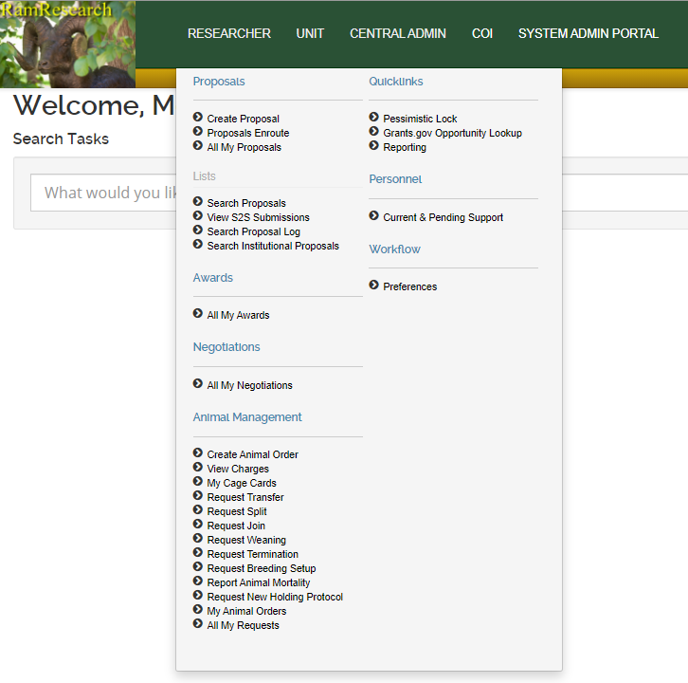
Open the Researcher menu and click the View Charges option under the Animal Management menu

Slide 3
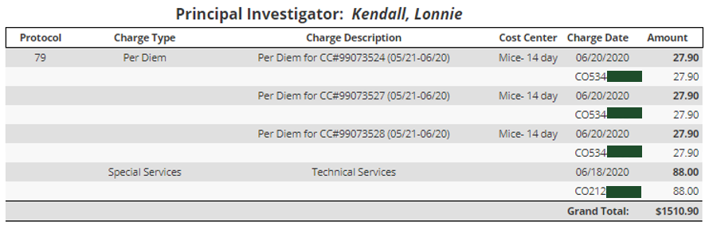
2) For the most descriptive report you will want to keep the View as ‘PI View’
3) If you are the PI, Press the ‘PI Last Period Unbilled’ to view the most recent billing period’s charges that are pending
> If you are not a PI, proceed to manually select charges (see step 8-10)
Charge Types will be grouped together per protocol
Charge Description will give more context for the charge (i.e. CC# or supply/service name)
Charges will be grouped by the protocol in the PI view. You will be able to see all the protocols that you are listed on
The account number can be seen directly below the charge line

Slide 4
4) From the PI View, you will be able to check the account for every cage card/ animal order/ special service that will be charged to your protocol
5) If you need to change a PER DIEM charge to a different account, submit a transfer with the correct accounting information; Include a note in the reason for the transfer that the transfer is to correct billing
a) If you believe there is a discrepancy with the per diems, please contact the LAR business office at LAR_animal_census@mail.colostate.edu
6) If the account associated with an ANIMAL ORDER needs to be changed, email Monica Rios & Megan Fritz for a correction
7) If the account associated with a SPECIAL SERVICE needs to be changed, email Monica Rios & Megan Fritz for a correction

Slide 5
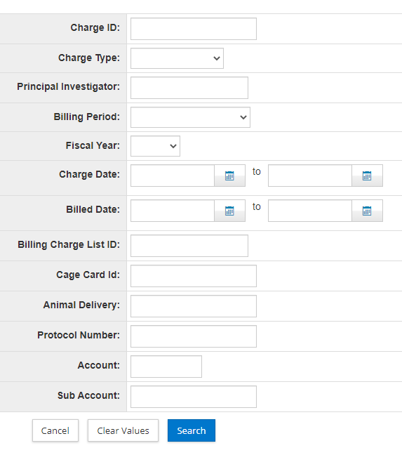
8) To search for charges if you are not a PI or if you need to see a different PI, click on the magnifying glass to Manually Select Charges
9) This will open a search from which you can select any Billing Period or search for charges specifically by Protocol Number or Account
a) At a minimum, select a Billing Period and enter in the PI or Protocol Number; Otherwise the search will return all charges across all billing periods.

Slide 6
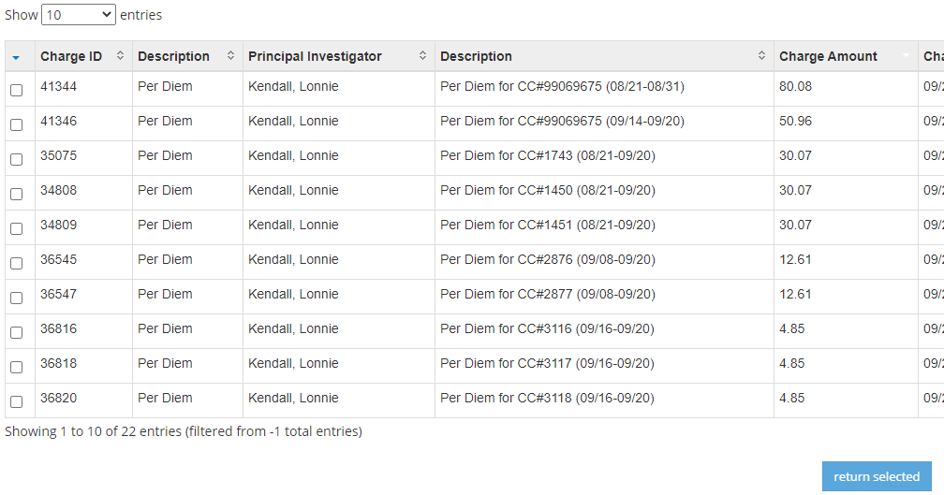
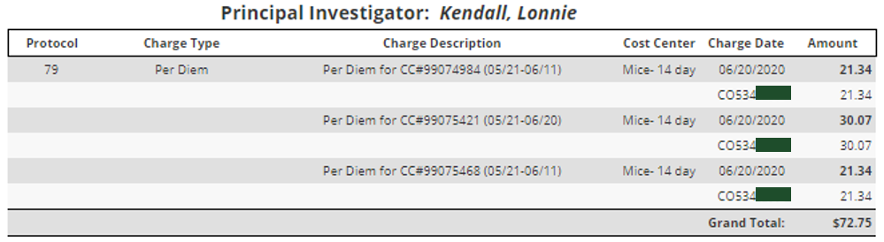
10) All charges that fit the criteria of your search will appear; then you can select the charges you would like consolidated into the PI View
a) Check the box next to each of the charges to be viewed and press the ‘Return Selected’ button below the table of results
b) All entries can be selected by clicking on the arrow in the upper left corner of the charges table and choosing ‘select all items’
b) The page will reload with the PI View Charges

Slide 7
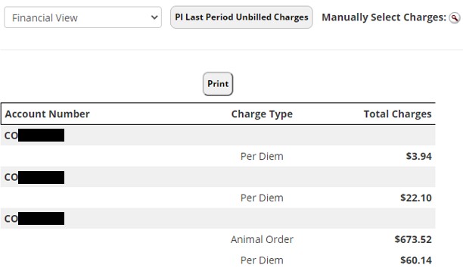
11) If you are interested in viewing the total charges per account for the billing period, change the view to Financial View and press the PI Last Period Unbilled button (or Manually Select Charges)
a) This view will consolidate all the charges by Account Number and by Charge Type
12) As long as Financial View is selected when you enter into the Charges Search, the charges returned will be in the Financial View

Slide 8
If you have any questions, please reach out to:
Megan Fritz
MeganR.Fritz@colostate.edu
(970)491-6012
Last Update: 11/20/2020

